Slide 1
Concept: National Asbestos Awareness Strategy
Asbestos Dialogue
24th of March 2017
Chemicals and Waste Management

Slide 2
PRESENTATION FRAMEWORK
Definition
Types and Uses of Asbestos
National Asbestos Strategy - Objectives
Legislative framework
Problem Statement
Concept – National Asbestos Awareness Strategy
Conclusions
1
2
3
4
5
6
7

Slide 3
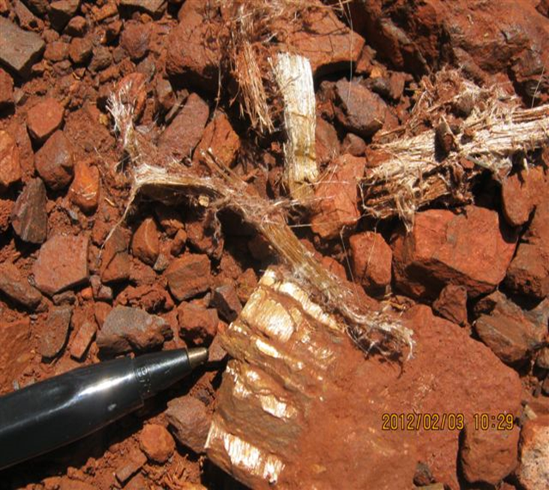
Definition of Asbestos
The term Asbestos designates a group of naturally occurring fibrous serpentine or amphibole minerals with historical commercial usefulness due to their extra ordinary tensile strength, poor heat conduction and relative resistance to chemical attack.

Slide 4
Forms of Asbestos
There has been three types of asbestos minerals mined in South Africa namely; Amosite, Chrysotile & Crocidolite.
Amosite-It is also known as brown asbestos and is like crocidolite, a member of the ampibole group.
Chrysotile- It is classified as a sheet silicate, that forms flat sheets of long, thin fibres. These fibres are the most flexible of all asbestos fibres; they can withstand the fiercest heat but are so soft and flexible that they can be spun and woven as easily as cotton.
Crocidolite- It is also known as colloquially as blue asbestos and is a member of the amphibole group. They are needle like fibres that are strongest of all asbestos fibres and have a high resistance to acids.
Notes:
Amosite:It has harsh spiky fibres that have good tensile strength and resistance to heat and was used frequently as a fire retardant in thermal insulation products, and in ceiling tiles.
Chrysotile: They had been in corrugated asbestos cement roof sheets typically used for outbuilding such as warehouses and garages.
Crocidolite: They are known to be the most lethal of all the asbestos types. They were commonly used to insulate steam engines, and were found in pipe insulation and cement products.

Slide 5
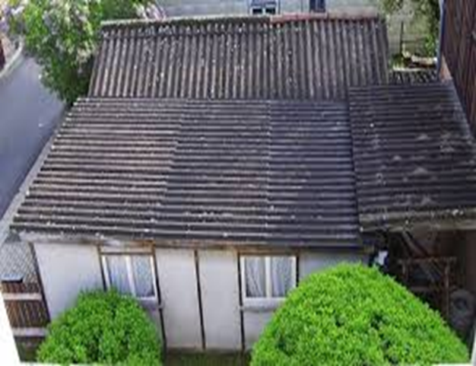
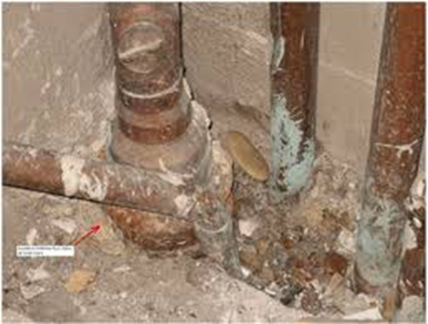
Uses of Asbestos Material
Notes:
Asbestos has been used by man in cement building materials, pipework lagging, insulating mattresses and rope, fire resistant insulation boards, sprayed fire-proofing products, floor tiles and coverings, water and sewage pipes, gas masks, fiction material for vehicle brakes and clutches, lifts and machinery. Boilers and pipework were lagged with asbestos production hospitals, power stations and throughout heavy industry.

Slide 6
Legislative framework
OHSA, Asbestos Regulations.
Mine Health and Safety Act
Asbestos Related Diseases Compensation laws (e.g. COIDA)
National Environmental Management Act
National Environmental Management Waste Act
Policy on the handling and disposal of asbestos and asbestos containing waste in terms of section 20 of the Environmental Conservation Act, 1989 (No 73 of 1989).
The Regulations for the Prohibition of the Use, Manufacturing, Import and Export of Asbestos and Asbestos Containing Materials.
Framework for the Management of Contaminated Land in South Africa, Annexure C

Slide 7
Problem statement
Asbestos is a known carcinogen and causes a variety of lung diseases ultimately leading to death.
Secondary pollution effects
Legacy of mining asbestos (Mine dumps)
Compensation for victims
Citizens are still exposed to asbestos due to inadequate information and poor asbestos management practices.
Little or no coherent asbestos management awareness strategy

Slide 8
National Asbestos Strategy
Aim of the strategy:
This strategy aims to facilitate integration and sustainable management of asbestos in the country

Slide 9
Objectives of the National Asbestos Strategy
To facilitate integration of awareness, consultation and sustainable remediation on asbestos
Implement Risk Based Approach on asbestos in the country
Create a platform to exchange information on best practices on asbestos
To establish communication framework to eliminate silos and fragmentations among role players
To supplement existing approach on management of asbestos to strengthen asbestos management system in the country.

Slide 10
Concept- Asbestos Awareness Strategy
Objectives:
Review existing material on asbestos awareness and campaigns
Improve awareness with respect to the risk of asbestos in homes, commercial buildings and secondary contamination
Integrate all asbestos related information
Develop a practical and evidence based asbestos awareness material
Identify industry needs and gaps in their asbestos awareness campaigns and programmes

Slide 11
Activities
One stop asbestos related information website
Advertise the website in government departments to increase its accessibility.
Publishing info on best practice with regards to asbestos removal, disposal and rehab of contaminated site.
Undertaking coordinated awareness campaigns targeting owners of asbestos buildings, removal contractors and citizens exposed to asbestos.
Collaboration amongst government, NGOs and community forums.

Slide 12
Expected Outcomes
Improved access to updated asbestos info.
Facilitated behavior and attitude change.
Enhanced awareness among the members of the public regarding the risk posed by asbestos containing material and its environmental, health and safety impacts.

Slide 13
The questions to be answered
What is the current asbestos awareness status in the country?
Any notable achievement with respect to awareness to date?
Who are we targeting on the strategy?
How will we measure success of the intervention?
Where to from here?

Slide 14
Conclusion
“We must do what we conceive to be right and not bother our heads or burden our souls with whether we will be successful. Because if we don’t do the right thing, we`ll do the wrong thing and we`ll be part of the disease and not part of the cure.”
Fritz Schumacher

Slide 15
Takalani Telekisa
Land Remediation Directorate
Tel: 012 399 8549
Ttelekisa@environment.gov.za

