Slide 1
Clariant Sasol Catalysts
SPA PolyMax catalyst manufacturing process

Slide 2
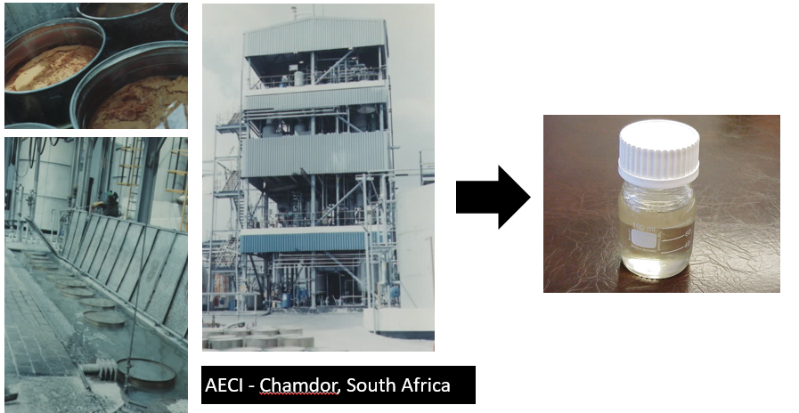
Raw material 1 – Polyphosphoric Acid (PPA)

Slide 3
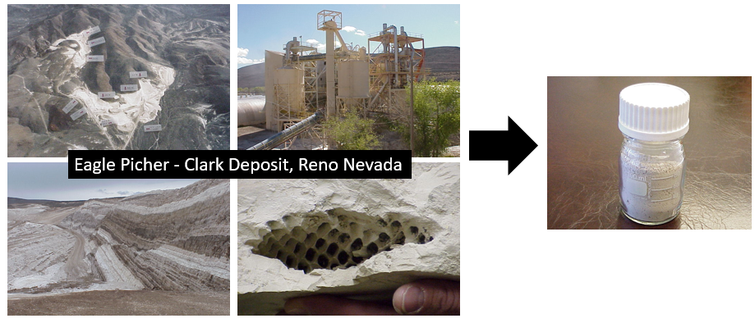
Raw material 2 – Kieselguhr (Guhr)

Slide 4
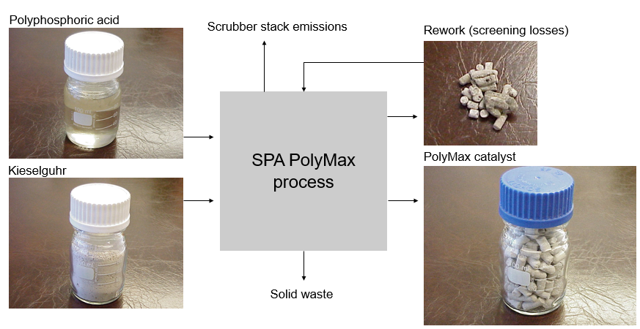
Process Flow

Slide 5
Process Flow
Guhr and phosphoric acid byproduct

