Slide 1
Removal of the Hazardous Nature of Asbestos Waste through Acid Treatment
Presented by: Nicholas Fleischman
Office: 011 316 1800
Email: nick@athermal.co.za
Asbestos Indaba
A-THERMAL RETORT TECHNOLOGIES (PTY) LTD
ENERGIA RUBBER TECH (PTY) LTD

Slide 2
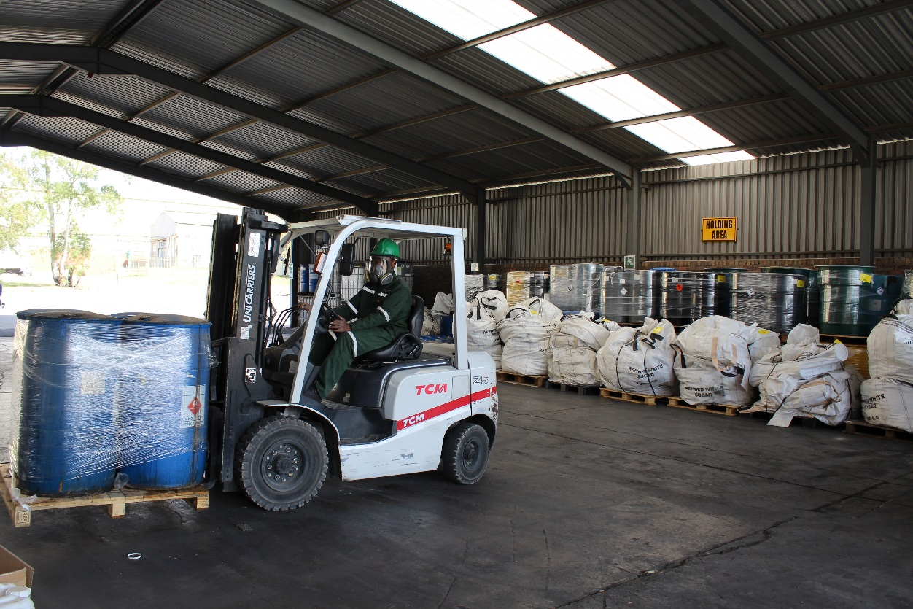
COMPANY SUMMARY
Operating since 1996 (20 years of operation)
Based in Olifantsfontein
Multiple Technologies
Treatment of Hazardous Waste (400 tpm) – chemical & pharmaceutical
A-THERMAL RETORT TECHNOLOGIES (PTY) LTD

Slide 3
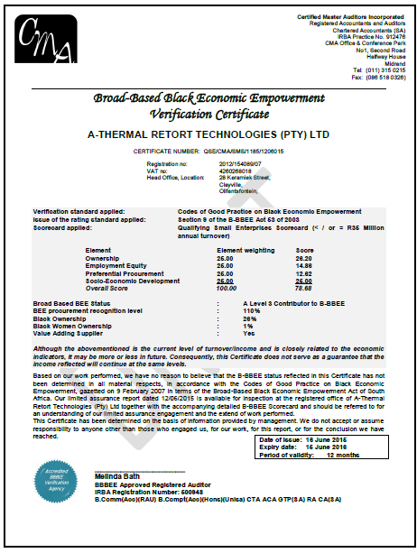
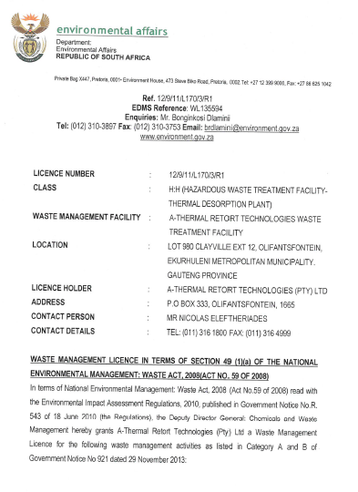
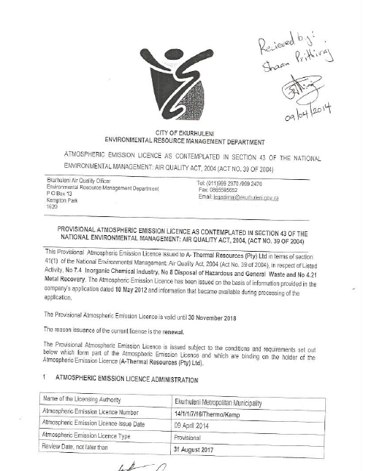
LICENCES
A-THERMAL RETORT TECHNOLOGIES (PTY) LTD

Slide 4
ISO CERTIFICATIONS
ISO 9001 Certified (Feb 2016)
ISO 14001 Certified (Nov 2009)
OSHAS 18001 Certified (Feb 2016)
A-THERMAL RETORT TECHNOLOGIES (PTY) LTD

Slide 5
AFFILIATIONS
CAIA – Chemical & Allied Industries’ Association
Promote Principals of sustainable development and continuous improvement in HSE performance
A-THERMAL RETORT TECHNOLOGIES (PTY) LTD

Slide 6
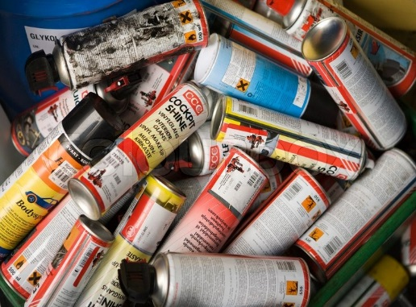
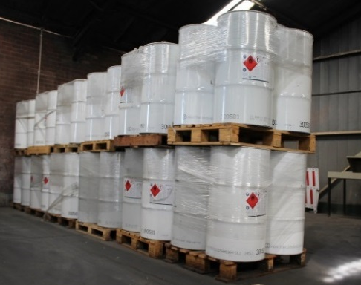
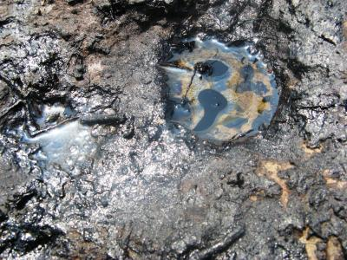
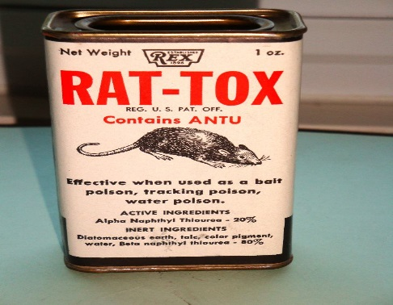
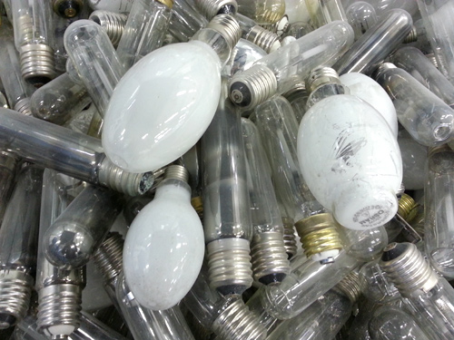
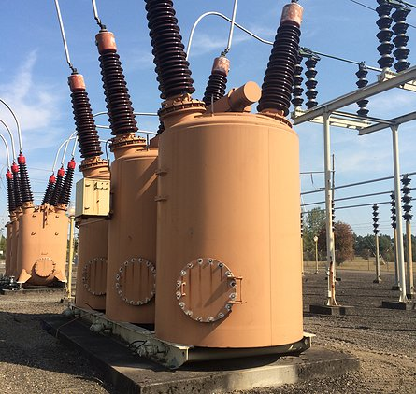
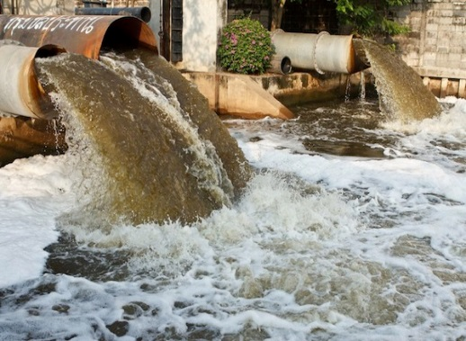
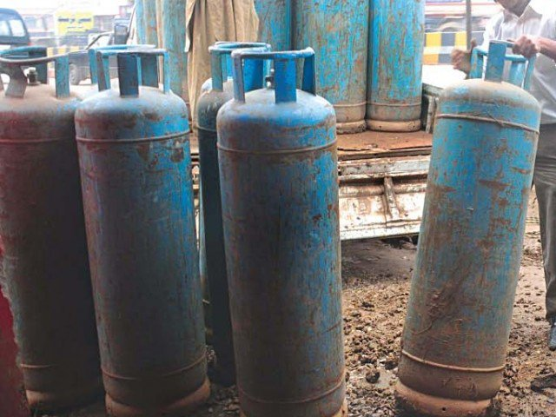
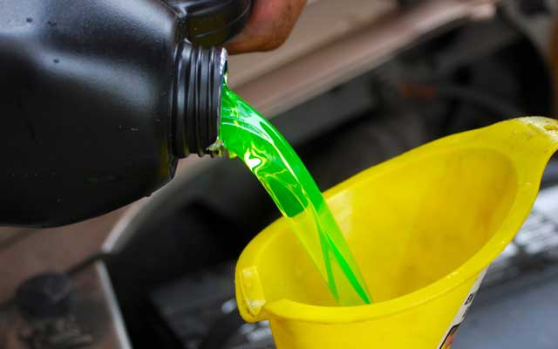
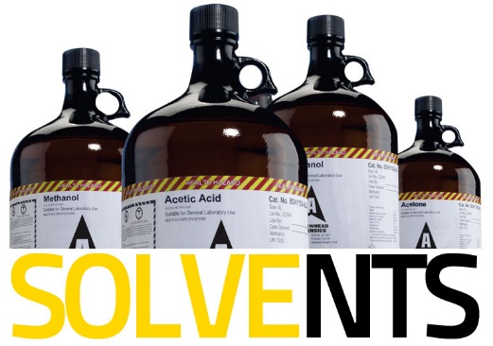
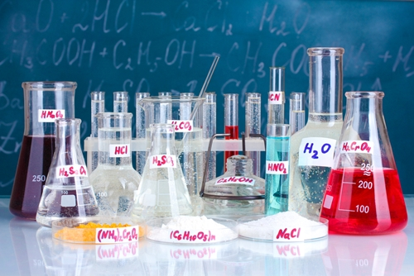
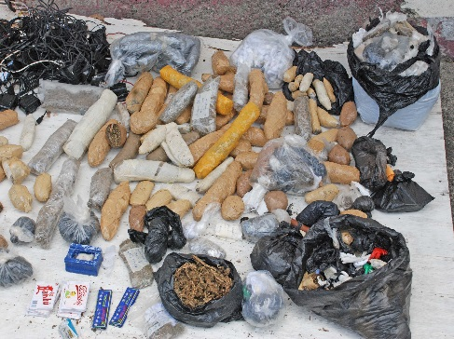
A-THERMAL RETORT TECHNOLOGIES(PTY) LTD

Slide 7
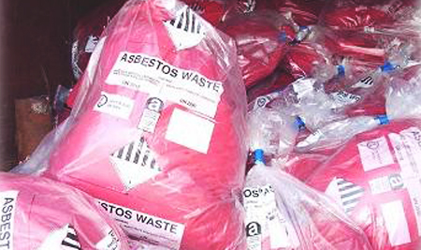
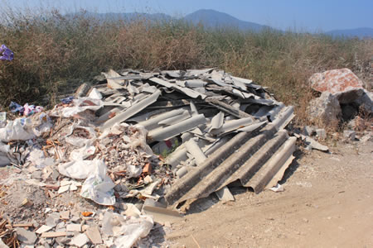
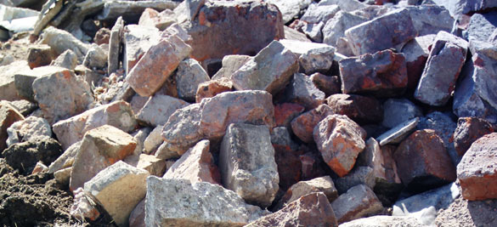
What is Asbestos Waste?
Fibrous silicate crystal
Asbestos Waste:
Contaminated PPE/Tools
Contaminated Soils
Building sheeting
Building rubble
Common (95%): Chrysotile –Mg₃Si₂O₅(OH)₄
A-THERMAL RETORT TECHNOLOGIES (PTY) LTD

Slide 8
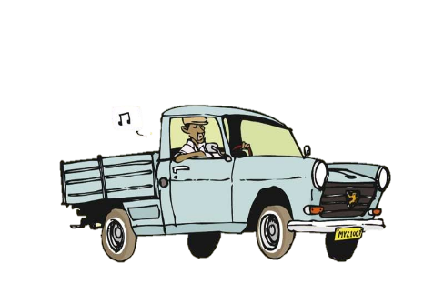
Options for Asbestos - Landfill
Benefits | Shortfalls
Low Cost | Consumes landfill space
 | Hazardous nature not removed
 | Okay to landfill if soil is kept wet. Dry soil => dust => dispersal
 | Historical poor practices: Contaminated Soil
A-THERMAL RETORT TECHNOLOGIES (PTY) LTD

Slide 9
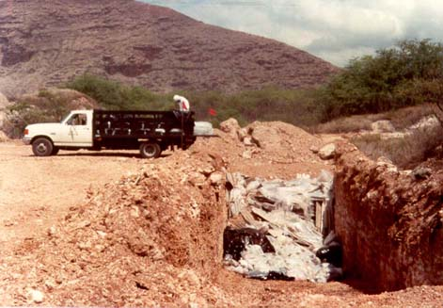
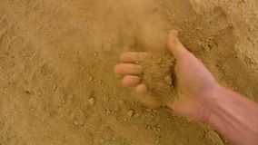
Options for Asbestos - Landfill
A-THERMAL RETORT TECHNOLOGIES (PTY) LTD

Slide 10
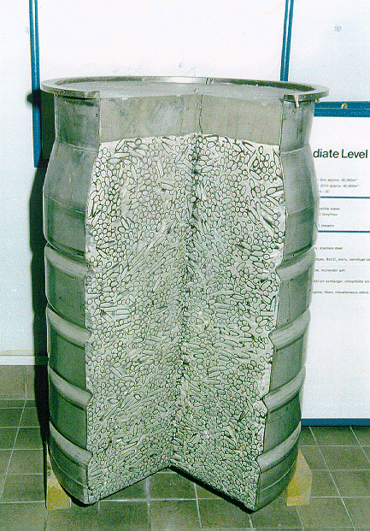
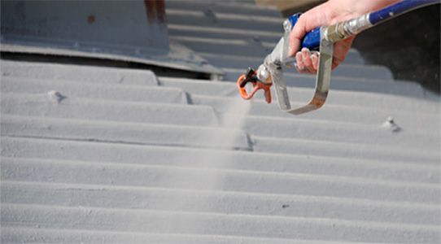
Options for Asbestos - Encapsulation
Containment within sealed or reinforced containers/cells
NEM:WA 59 of 2008, Norms & Standards for Disposal to Landfill: Macro-Encapsulation Phase out by 2021
A-THERMAL RETORT TECHNOLOGIES (PTY) LTD

Slide 11
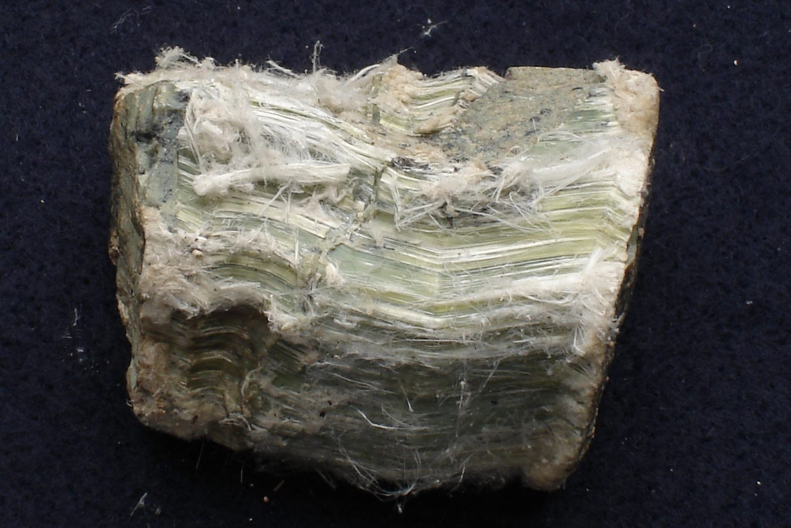
Options for Asbestos - ?
A-THERMAL RETORT TECHNOLOGIES (PTY) LTD

Slide 12
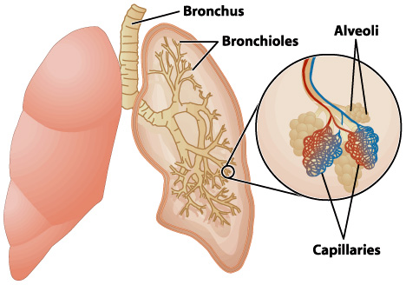
Normal Dust Behaviour
A-THERMAL RETORT TECHNOLOGIES (PTY) LTD

Slide 13
Asbestos Dust Behaviour
A-THERMAL RETORT TECHNOLOGIES (PTY) LTD

Slide 14
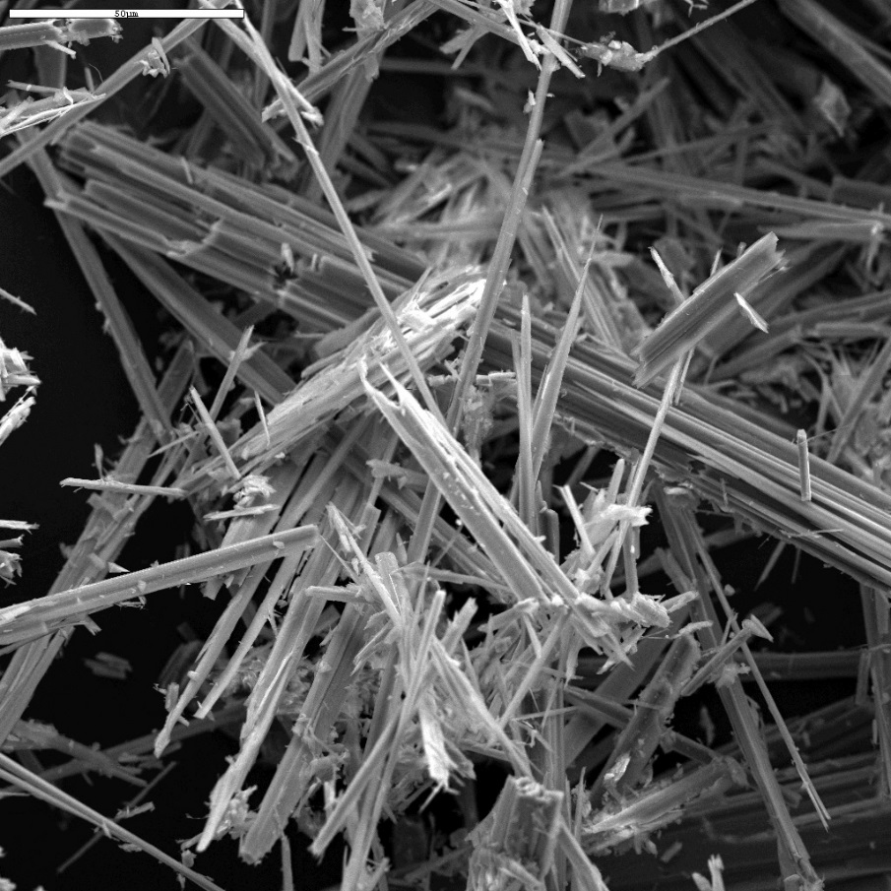
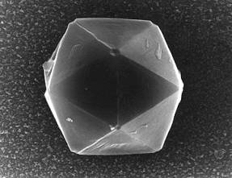
Options for Asbestos
– Acid Treatment
Mg₃Si₂O₅(OH)₄
SiO₂ (Silica)
A-THERMAL RETORT TECHNOLOGIES (PTY) LTD

Slide 15
Options for Asbestos
– Acid Treatment
Salt
MgSO₄
3
Salt
MgSO₄
Chrysotile
Mg₃(Si₂O₅)(OH)₄
Acid
+ 3H₂SO₄
Silica
+ 2SiO₂
Water
+ 5H₂O
Lime
+ CaOH₂
Salt
CaSO₄
Salt
+ Mg(OH)₂
A-THERMAL RETORT TECHNOLOGIES (PTY) LTD

Slide 16
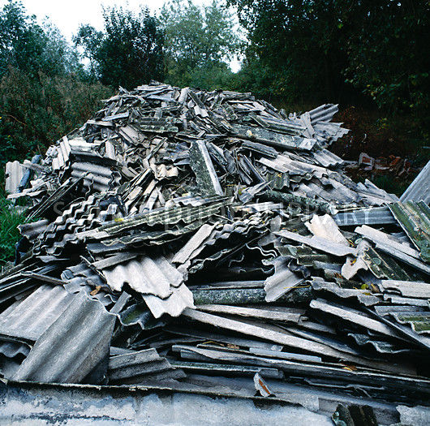
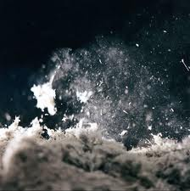
Options for Asbestos
– Acid Treatment
Range of waste sizes
Dust formation
A-THERMAL RETORT TECHNOLOGIES (PTY) LTD

Slide 17
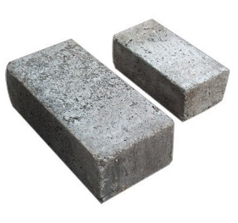
Asbestos – Acid Treatment
3 MgSO₄ + 2SiO₂ + 5H₂O + CaOH₂
=> 2SiO₂ + 5H₂O + CaSO₄ + Mg(OH)₂
Mg₃(Si₂O₅)(OH)₄ + 3 H₂SO₄
=> 3 MgSO₄ + 2SiO₂ + 5H₂O.
Strong cement qualities
Neutraliser
Non hazardous Slurry
Acid (Waste)
A-THERMAL RETORT TECHNOLOGIES (PTY) LTD

Slide 18
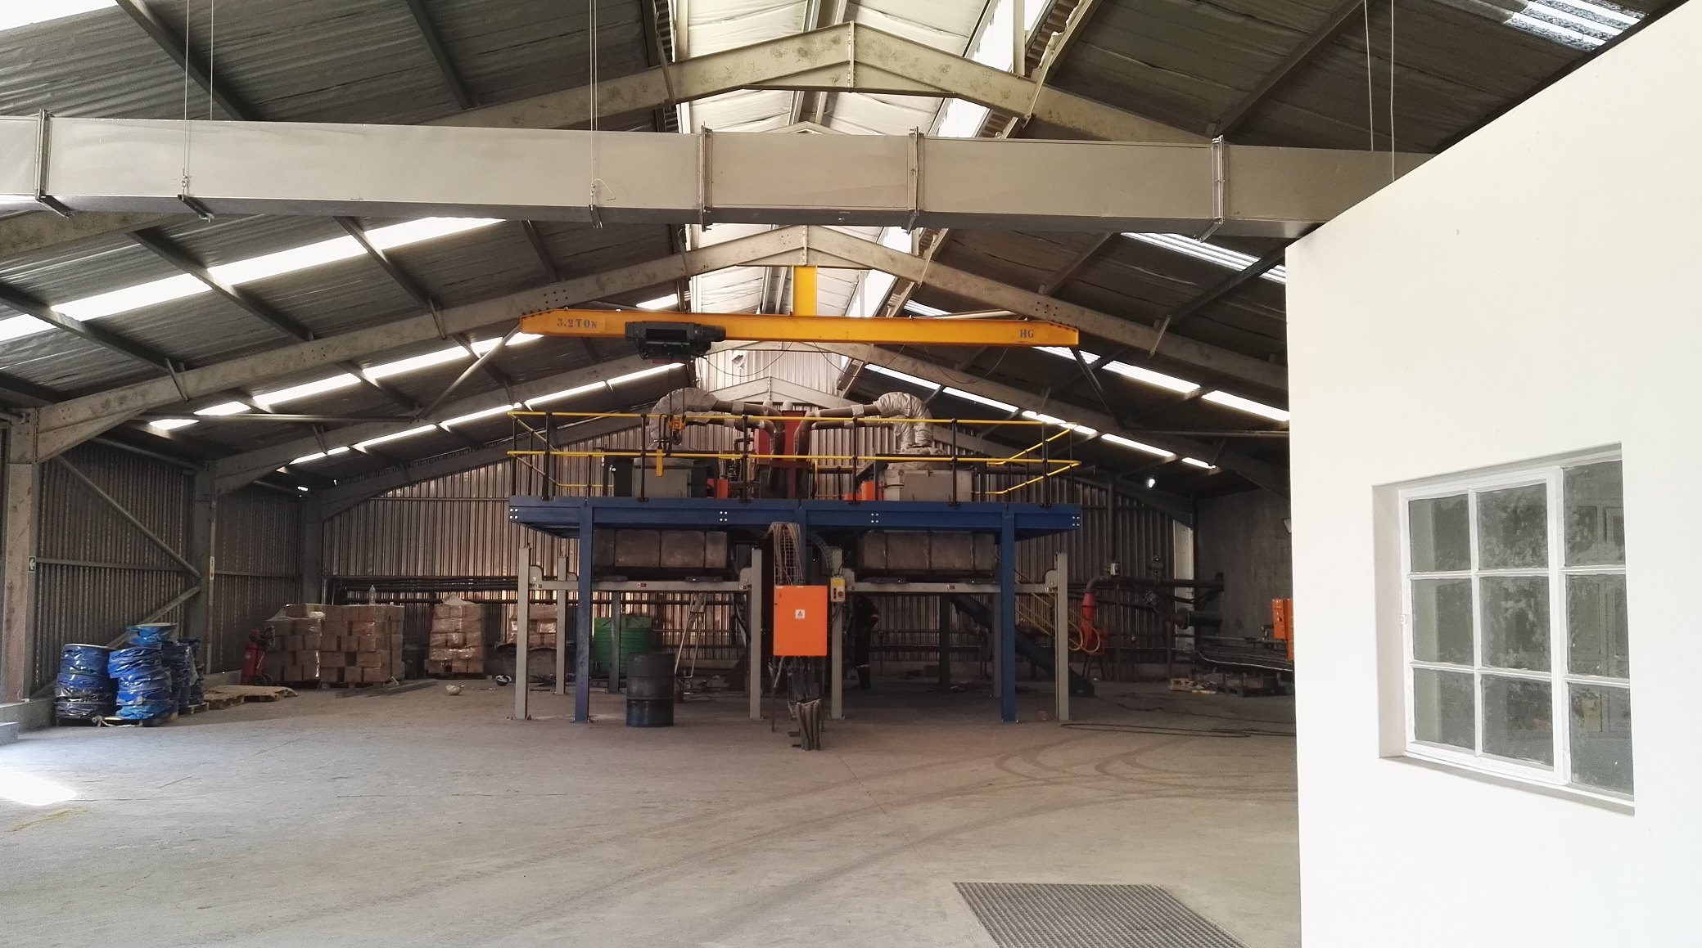
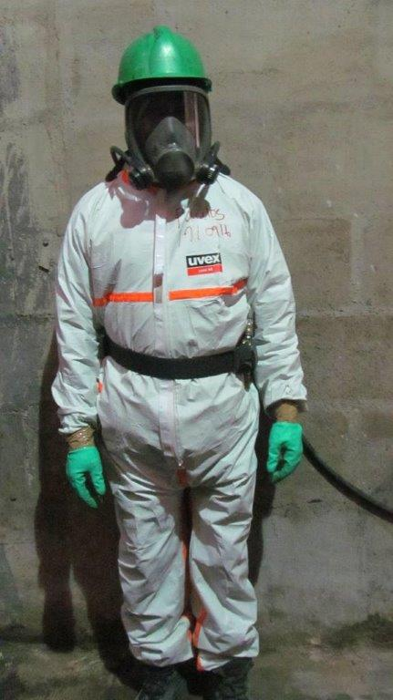
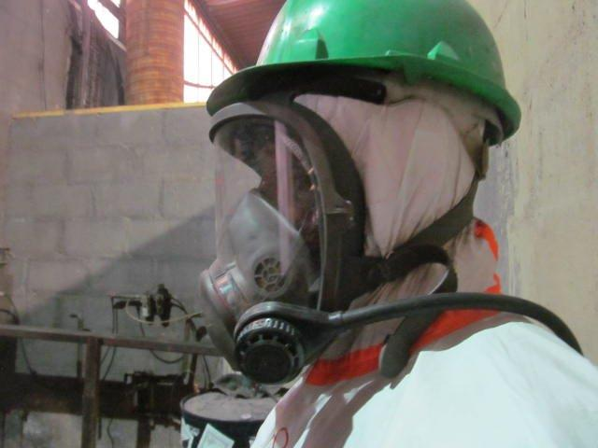
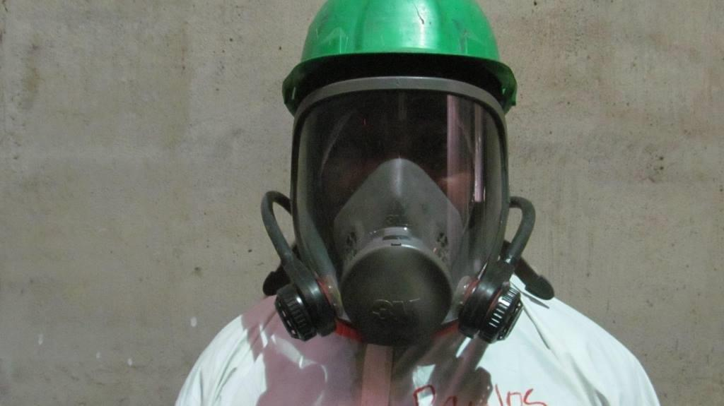
Containment of Asbestos Fibres
A-THERMAL RETORT TECHNOLOGIES (PTY) LTD

Slide 19
Containment of Asbestos Fibres
Medical Surveillance
24/7 Air Monitoring
Respiratory PPE
“Reduce exposure to the lowest level reasonably practicable”
A-THERMAL RETORT TECHNOLOGIES (PTY) LTD

Slide 20
Options Summary
Landfilling / Encapsulation | Acid Treatment
Low Cost | Moderate Cost
Consumes landfill space | No Landfill space consumed
Hazardous nature not removed | Hazardous nature completely removed
Dry soil = dust = dispersal of asbestos | No future concerns = peace of mind
No volume reduction | 50-90% volume reduction depending on waste treated
No Re-use | Potential for Re-use (Cement)
A-THERMAL RETORT TECHNOLOGIES (PTY) LTD

Slide 21
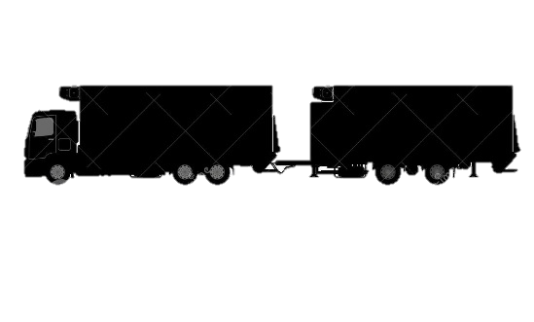
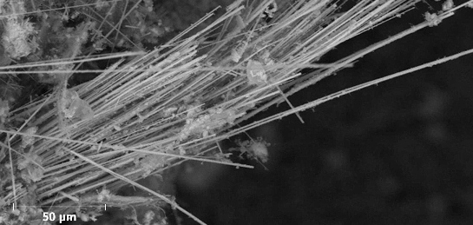
Challenges to consider
A Mobile Plant?
Collection and transport not contained
– risk of asbestos release
Quantities available?
How to compete with landfill financially ?
A-Thermal Plant is well contained | A Mobile plant is more difficult to contain fibres
A-THERMAL RETORT TECHNOLOGIES (PTY) LTD

Slide 22
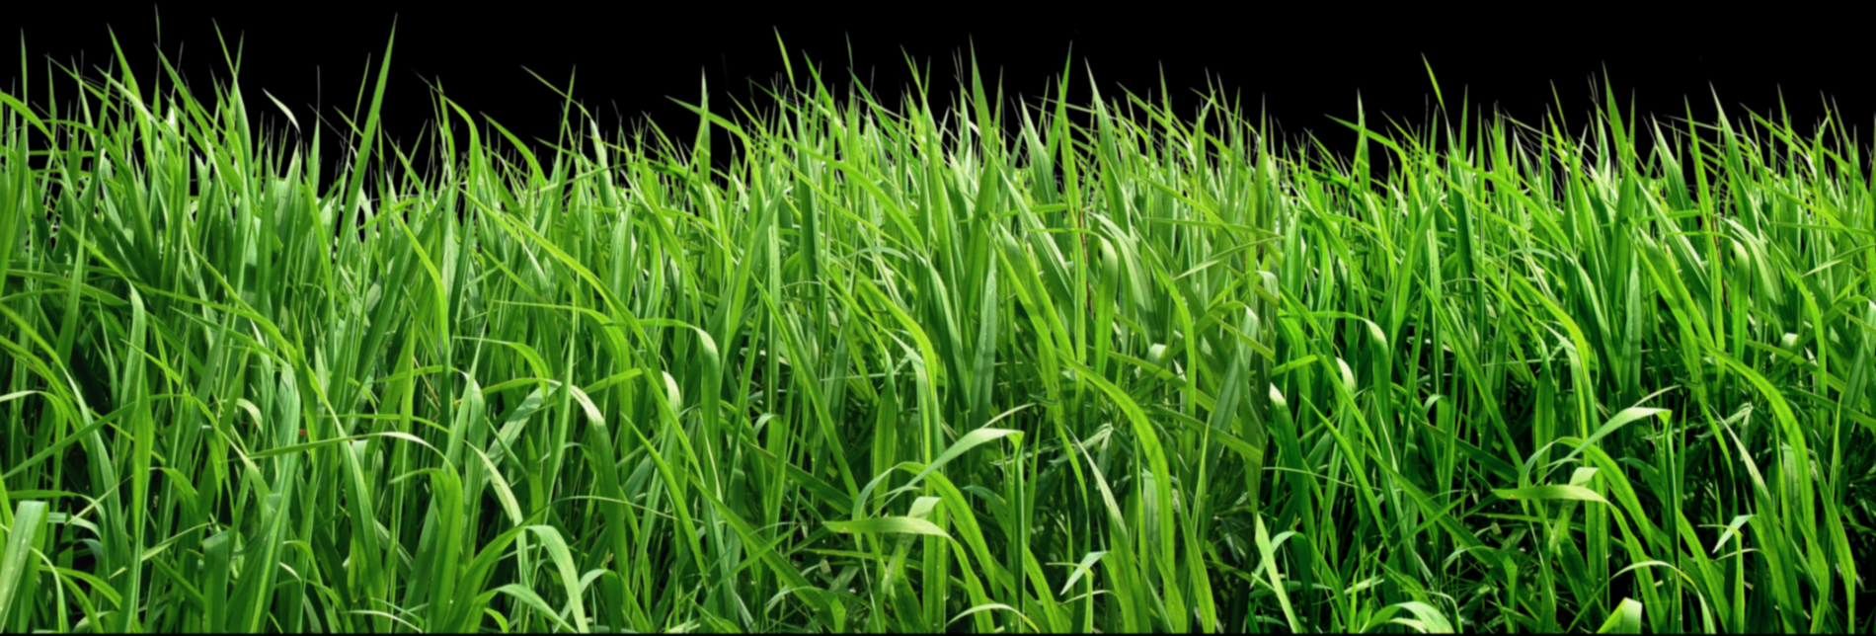
Questions?
A-THERMAL RETORT TECHNOLOGIES (PTY) LTD

