Slide 1

THE POSSIBILITIES & CHALLENGES FACED WHEN ADDRESSING ASBESTOS CONTAMINATION: A MODERN PROJECT CASE STUDY
LP-PENGE ASBESTOS REMEDIATION PROJECT
ASBESTOS DIALOGUE
23 March 2017

Slide 2

OUTLINE
SITUATIONAL AWARENESS
FUNDAMENTALS
AVAILABLE RESOURCES
COMMUNICATION
CHALLENGES
BUSINESS PLAN DISPUTES POST SIGNATURE
PENGE BRIEF

Slide 3
DENOVOS ROLE
DeNovo is a non-partisan actor
DeNovo will perform at the highest professional standard at all times
DeNovo will respect the decisions brought forward in the project. Non-negotiable
DeNovo serves to act in any capacity such that the project can be successful

Slide 4
SITUATIONAL AWARENESS
Fundamental understanding of project
  Memorandum of Agreement
  Business Plan
  Procurement
  Planning/Implementation
Fundamental understanding of project dynamics
  Stakeholders
  Politics
  Business
  The unknown

Slide 5
BUSINESS PLAN
Fundamental understanding of project
  Memorandum of Agreement
  Business Plan
  Procurement
  Planning/Implementation
Fundamental understanding of project dynamics
  Stakeholders
  Politics
  Business
  The unknown

Slide 6
BUSINESS PLAN
Identify potential areas of concern early in the project
  Hostile stakeholder
    Individual
    Community
    Company
  Changes to the Scope
    Critical lead items
    Effects on budget & duration
  Land Issues
    Owning Entity
    Land Resolutions

Slide 7
PROJECT REPORTING CHALLENGES
Project Scope
  Penge Primary
  Ga-Mopedi
  Penge Roads
EPWP
  Project Wage Rate
  Project Duration
  Penge Sanco

Slide 8
COMMUNICATION CHALLENGES
Imperative that the IA develop lines of communication early on in the project with stakeholders
Do not underestimate the importance of spending time with the project participants
Take the time to discuss the particulars of the business plan with all stakeholders
Terms of reference
Governing entities and their responsibility
PROJECTS ACTING OUTSIDE BASIC GUIDELINES

Slide 9
TRAINING
Effect of duration and budget
  Non-accredited training plan
  Department cannot audit skills assessment post project
    Not enough time for participating parties to coordinate
    Project budget does not allow

Slide 10
LABOUR DISPUTE POST BUSINESS PLAN SIGNATURE
It was brought to DeNovo s attention February 7th, 2017 that a dispute with the project wage rate was being brought forward by the community. The community feels they were marginalized during the project planning stages and as a result their voice is going unheard. There exists the possibility of the community leadership attempting to steer the project from implementation back into the planning phase. The project is suffering from a collapse in the lines of communication. There exists a serious lack of trust between the Department, Municipality, and Penge Sanco (Village Leadership). Penge Sanco has put forth the claim they were not told this project fell under the EPWP guidelines until February 7th,2017 during a project meeting discussing the issue of wage rates.

Slide 11
PENGE PROGRESS
Original Project Duration
Start Date | End Date | Total No. of Months | No. of Months Remaining
01/12/2016 | 01/06/2017 | 6 | -
Revised Project Duration
Start Date | End Date | Total No. of Months | No of Months Remaining
08/03/2017 | 08/05/2017 | 2 | 1.5

Slide 12
PENGE EPWP EMPLOYMENT
 | Planned Number of Actual People | Number of Actual People
Clerical | 0 | 0
Labourers | 22 | 50
Semi Skilled | 0 | 0
Skilled | 25 | 0
Supervisors | 2 | 0
Managerial | 0 | 0
Number | 50 | 0
Person Days | 3300 | 2200

Slide 13
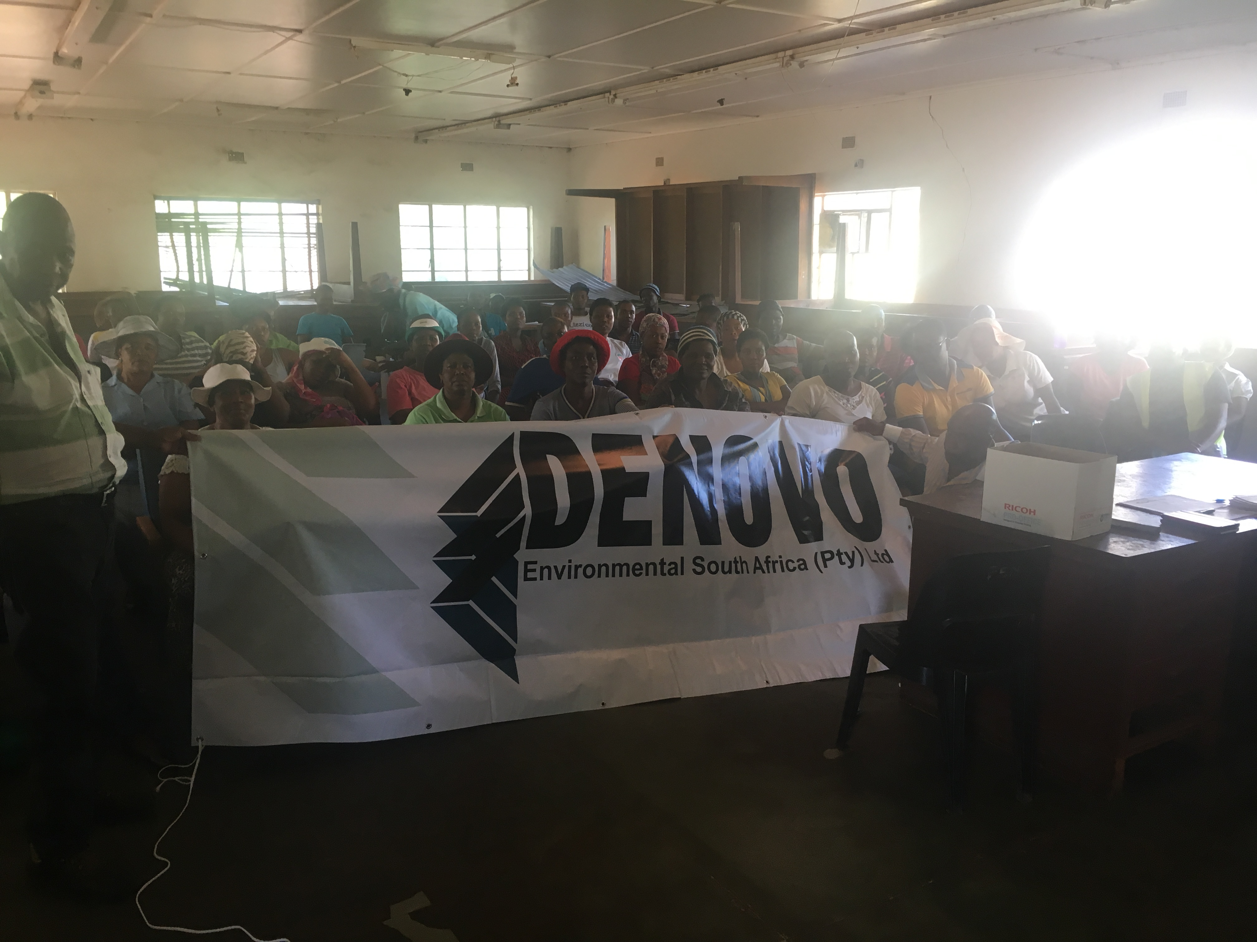

Slide 14
THANK YOU

