Slide 1
National approach to the Remediation of Secondary Asbestos Contamination Chemicals Management & Land Remediation Summit CSIR ICC, Gauteng, 5 October 2015 Dr Mpho Tshitangoni
Chemicals and Waste Management

Slide 3
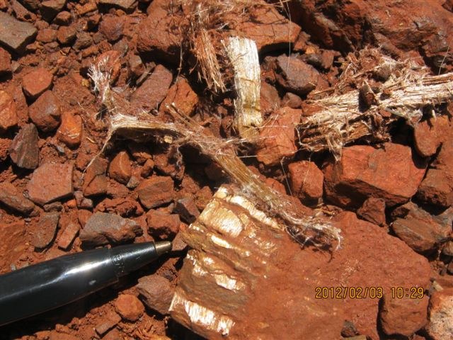
Presentation outline
Introduction
Findings of the Secondary Asbestos Remediation Plan(SARP)
Remediation options
The need for remediation
Conclusion

Slide 4
Introduction
DEA was tasked by Cabinet in 2004 to undertake a study to assess the extent of secondary asbestos contamination in SA
The study was completed in 2006 and showed that there are different levels of contamination in four provinces (NC, L, MP, NW).
Following the 2006 study, the DEA took the study further by developing (in 2008) a remediation plan & costing model for contaminated areas
The 2008 study (Secondary Asbestos Remediation Plan) included the social impact assessment (SIA) to assess how exposure to asbestos has affected the socio-economic aspects of relevant communities)

Slide 5
Introduction Cont…Purpose of the 2008 Study
After verifying the problem of asbestos in the 4 provinces, the 2008 aimed to develop a Remediation Plan and Costing Model for the rehabilitation of the contaminated areas.
Remediation will ensure that Government implements Section 24 of the Constitution of South Africa Act (No. 108 of 1996) - (a) To an environment that is not harmful to their health or well-being
Remediation will also ensure protection of the health of the residents hence assist in the poverty alleviation of the affected communities as the diseases caused by asbestos render adults inactive and unproductive

Slide 6
Findings of the SARP
What is asbestos?
Asbestos is a group of fibrous mineral silicates
Where is asbestos found?
Raw asbestos is naturally occurring, but has been exposed by mining activities
Asbestos has been mined in Mpumalanga, Northern Cape, Limpopo and North West Provinces (See next slide for areas affected by asbestos contamination)
Where was asbestos used?
Due to its durability, asbestos was used in a variety of ways, including building materials, cement products, textiles, fireproofing, and several other uses.

Slide 7
Findings of the SARP Cont…

Slide 8
Findings of the SARP Cont…
What is asbestos contamination?
Primary asbestos contamination: contamination from areas where asbestos was mined, milled, stockpiled and transported prior to processing into final product. This include areas located within the jurisdiction of the Department of Mineral Resources
Secondary asbestos contamination: contamination of the general environment resulting from transport, storage or usage of asbestos as a result of historic mining. This include areas outside the jurisdiction of DMR

Slide 9
SARP`s Summary of all affected Provinces

Slide 10
Impacts of Asbestos Exposure
Asbestos can cause several lung diseases (referred to as asbestos related diseases: ARDs)
Main three types of ARDs:
Asbestosis : is a dust disease of the lungs
Mesothelioma: a disease of the lining of the lung and abdominal cavities
Lung Cancer: occurs when certain cells in the lung divide uncontrollably

Slide 11
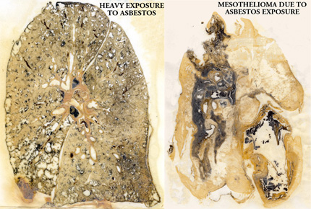
Impacts of Asbestos Exposure: Cont…
Normal lung of a person who has not been exposed to asbestos
Lung of a person who has been exposed to asbestos

Slide 12
At cross roads
No Action Alternative: In this regard all the contaminated areas will be left the way they are (unrehabilitated)
In-situ Remediation: In this regard there will be a need for temporary relocation of the community while remediation is being carried out (estimated 10 yrs)
Permanent Relocation: In the regard minimal or no remediation will be applicable, but will be case specific. This can be regarded as the most reliable and permanent solution to the problem. However, this is dependent on whether the communities are willing to relocate and the extent of contamination

Slide 13
No-Action Option
Based on the studies conducted throughout the world regarding the severity of exposure to asbestos, this option is DEFINITELY not a favorable one
Failure to take action will mean that the rights of the communities will continue to be infringed
The health costs will in the long run be too much as compared to the cost of remediation

Slide 14
In-situ Remediation Option
This will be site specific (case-by-case)
Specific communities may be broken down into sections
Will require temporary relocation of residents in blocks while remediation work is being completed
Communities will be informed of certain risks that will remain after the work is complete and how to minimise exposure
Requires follow-on maintenance and monitoring which can be done with the help of the community to ensure sustainability of the activity
In situ methods include:
Encapsulation: cover with soil, concrete, tarred roads, etc.
Renovation and rebuilding of structures
Excavation and removal of contaminated soil

Slide 15
Minimal Remediation and Permanent Relocation Option
This option will entail minimal remediation (bulldoze and cover contaminated areas, entire communities or only the contaminated portion of the community)
Permanently resettle communities on lands declared clean and suitable
Will require extensive public engagement
Will require active monitoring to ensure the areas do not become re-occupied.
This can be less costly in the long run due to lower maintenance costs and reduced risk of exposure

Slide 16
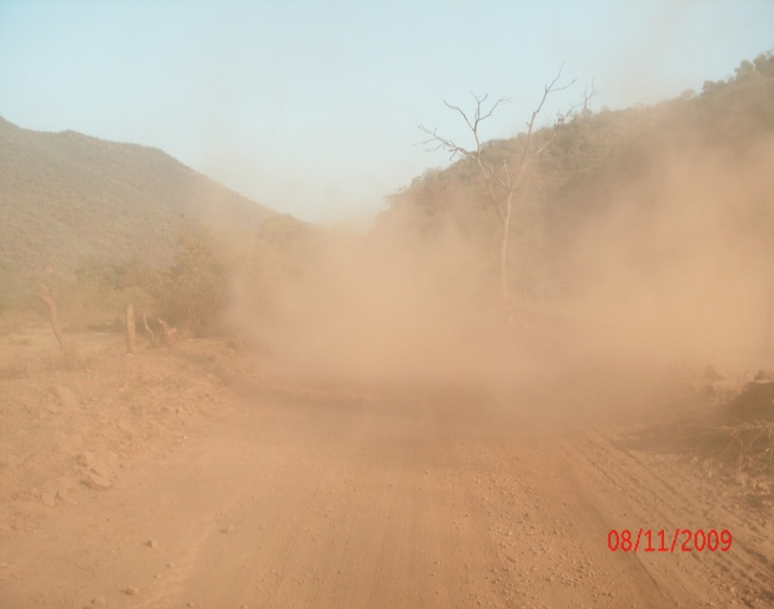
The need for Remediation
Affected communities are located in rural areas where roads are not tarred & dust generation is the most common way of migration of asbestos fibres
Rehabilitated roads will reduce the release of asbestos fibres into the atmosphere, hence reducing exposure to asbestos

Slide 17
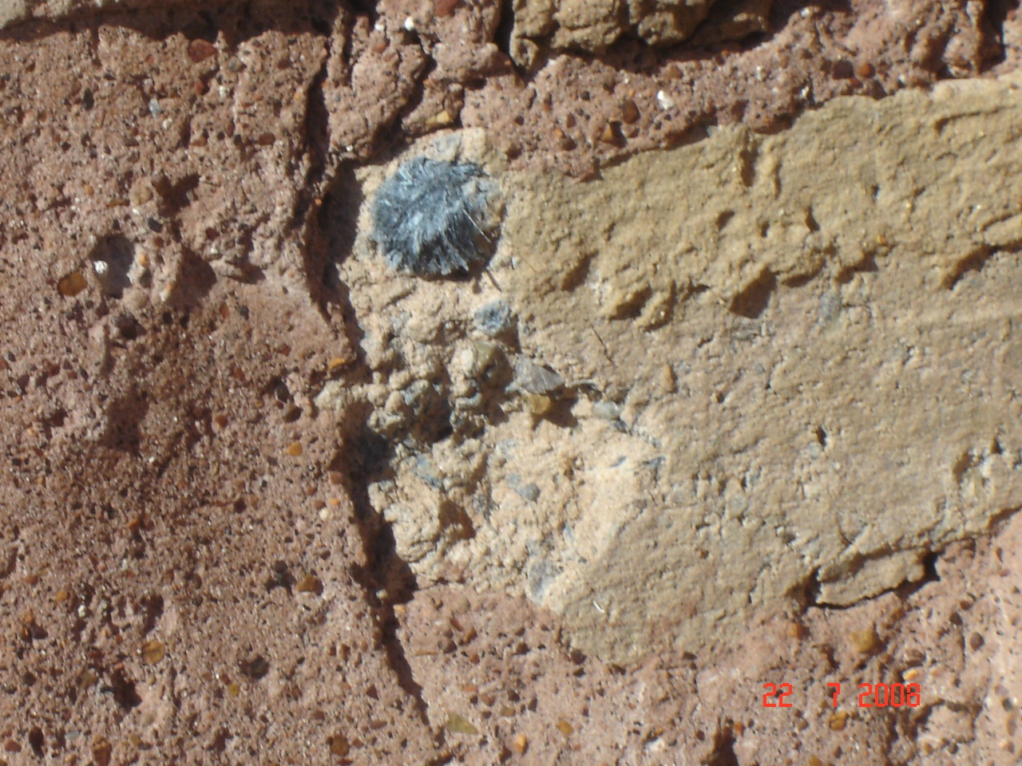
The Need for Rehabilitation: Cont…
Houses, churches, clinics and other infrastructure have been constructed from asbestos contaminated soils and materials exposing populations to asbestos on a daily basis and remediation of these facilities would help significantly.

Slide 18
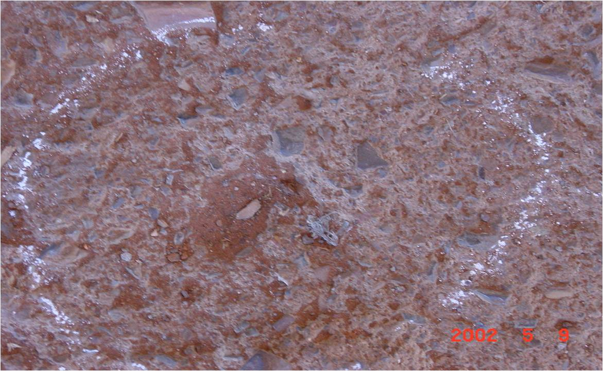
The Need for Rehabilitation: Cont…

Slide 19
Conclusion
It should be noted that there is neither a cure nor medication to elongate the lives of ARD sufferers with exception of prevention through remediation and/or relocation.
According to the study, the latency of Mesothelioma is about 30 – 40 years and it takes about one year from the time the symptoms of Mesothelioma starts to show for a person to die.
Unlike most terminal diseases which can be avoided, communities exposed to asbestos are very poor with little choices in terms of relocation hence require Government intervention.
The findings of the Secondary Asbestos Remediation Plan and Funding Model study has been approved by Cabinet
The implementation of the SARP is underway

Slide 21
Dr. Mpho Tshitangoni
Director: Land Remediation
012 399 9793/083 233 5926

