Slide 1
GOOD GREEN DEEDS PROGRAMME
DEPARTMENT OF ENVIRONMENT,FORESTRY AND FISHERIES

Slide 2
Presentation outline
Introduction and Background
Problem Statement
Situational Analysis
Good Green Deeds Goals
Good Green Deeds Objectives
Awareness Raising Platforms
Individual contributions to GGD
DEFF Overall Expectations
Conclusion

Slide 3
Introduction & Background
The Department of Environmental Affairs is mandated to give effect to the right of citizens to an environment that is not harmful to their health or wellbeing, and to have the environment protected for the benefit of present and future generations.
To this end, the department provides leadership in Environmental Management, Conservation and Protection towards sustainability for the benefit of South Africans and the global community.

Slide 4
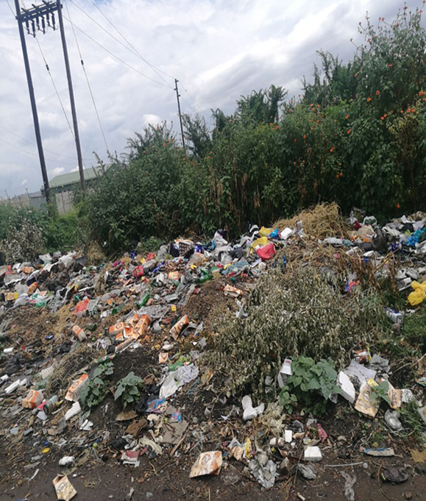
Problem Statement
A historical backlog of waste services
for, especially, urban informal areas,
tribal areas and rural formal areas
exacerbates the littering problem.
Waste generation is increasing
with population growth, urbanisation,
Etc.

Slide 5
Situational Analysis
The waste services access remains highly skewed in favour of more affluent and urban communities.
Ineffective waste management practices affect the well-being of the affected communities and this can be further exacerbated by the increased illegal dumping and littering.
Inadequate waste services lead to unpleasant living conditions and a polluted, unhealthy environment.
It is quite evident that littering and illegal dumping are some of the most common problems in South Africa affecting all provinces.

Slide 6
Good Green Deeds Programme Goals
The main purpose is to change people’s attitudes and behaviour towards waste and its management, as well as to begin taking charge and responsibility of keeping their neighbourhood clean
The Good Green Deeds Programme seeks to encourage individuals and organisations to come together to conduct clean-up centred activities across South Africa and rehabilitate the illegal dumping areas

Slide 7
Good Green Deeds Programme Goals
The objective is to instill environmental friendly behavior and create a national culture in which citizenry is aware of its role in attaining a cleaner and healthy environment through:
i) Litter-free and no dumping behavior: The SA citizenry to be made aware of the impacts of poor waste management on their health and environment as well as being taught about on proper management of their own waste to keep their surroundings clean.
ii) Waste minimization: Encourage communities to have less waste generation rates through promoting separation at source, re-use, recycle and recovery of their waste and making available infrastructure to allow that behavioral change i.e. Buy-back centers or Drop-offs.
iii) Opportunities in waste: Advocate for entrepreneurship in the waste industry and access to green economy at the same time keeping our country clean. The recyclables would strengthen the manufacturing industry and promote sustainable production and consumption.

Slide 8
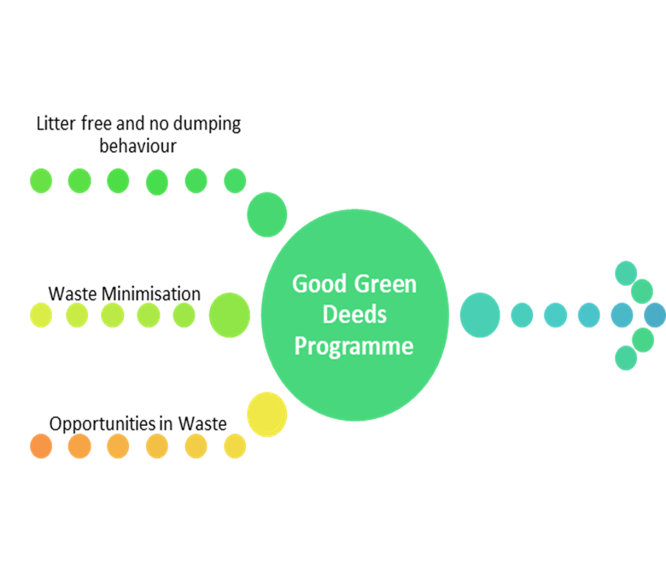
Good Green Deeds Programme Goals

Slide 9
Good Green Deeds Programme Objectives
The DEA has realized that more efforts are needed if the environment is to be protected from pollution and has decided on a national Good Green Deeds Programme (GGD) to mobilise every citizen.
This is a nationwide environmental programme that proposes a simple but bold blueprint for what we all can do as individuals, Industries, organisations, faith based organisations, communities and as a nation to bring about the realisation of a cleaner and more environmentally presentable country.

Slide 10
Good Green Deeds Programme Objectives
The main purpose is to change people’s attitudes and behaviour towards waste and its management, as well as to begin taking charge and responsibility of keeping their neighbourhood clean
The Good Green Deeds Programme will encourage individuals and organisations to come together to conduct clean-up centred activities across South Africa and rehabilitate the illegal dumping areas

Slide 11
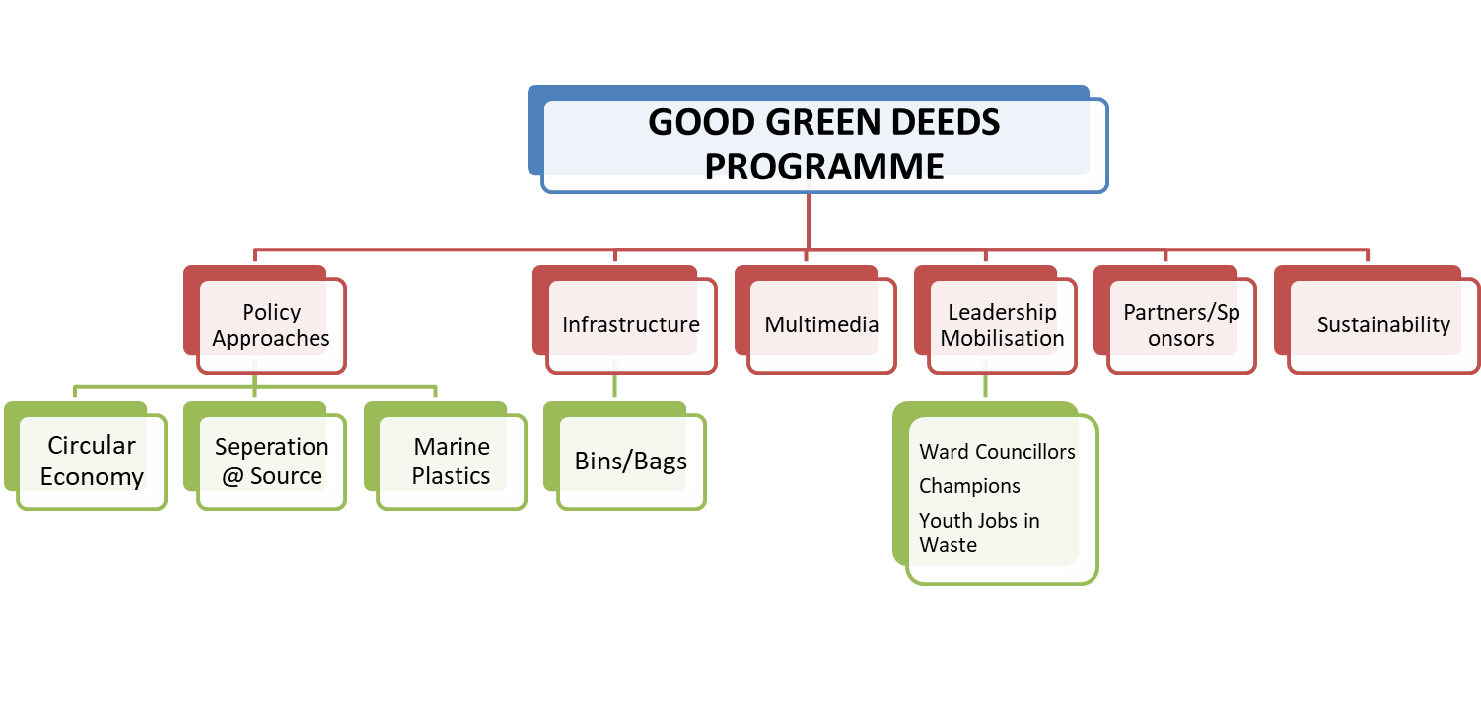
Good Green Deeds Programme Objectives

Slide 12
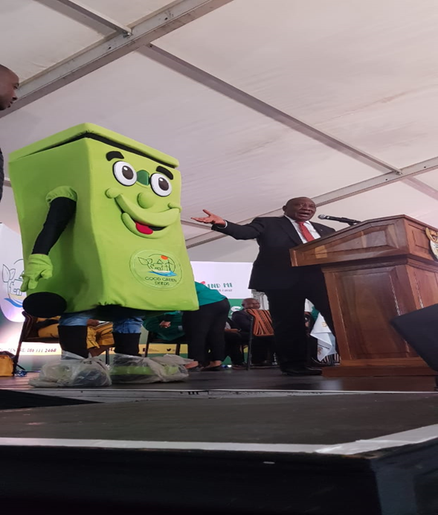
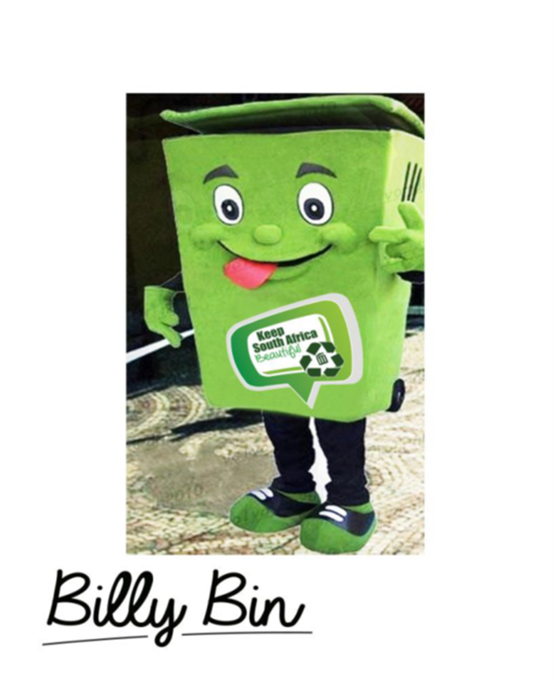
Awareness Platforms

Slide 13
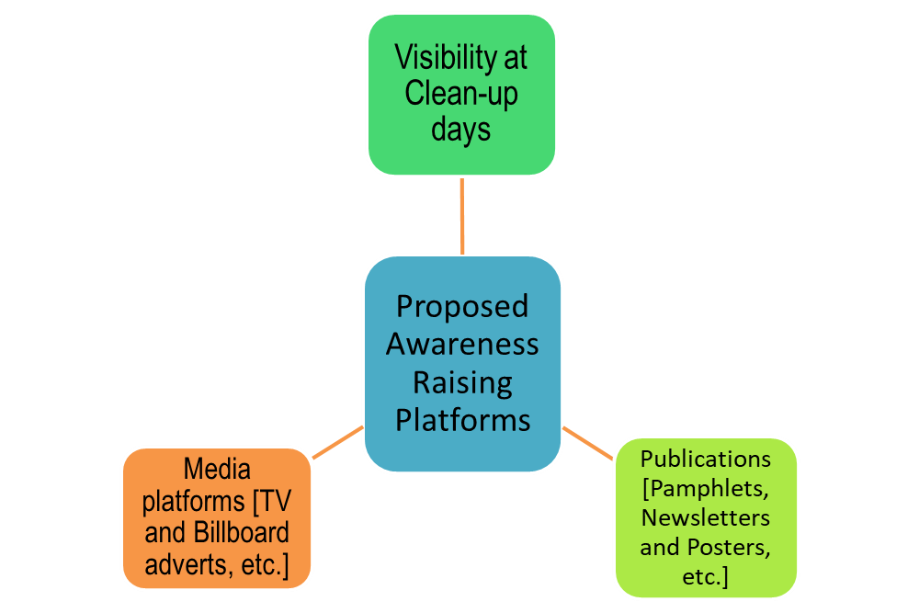
Awareness Platforms

Slide 14
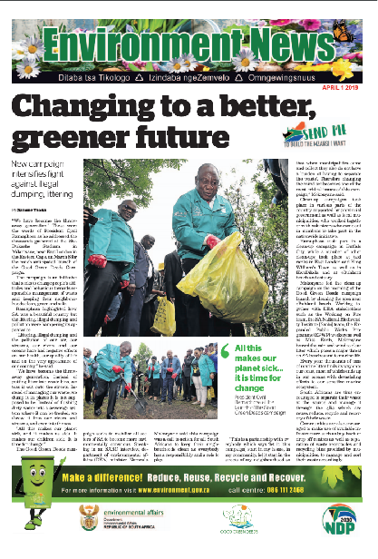
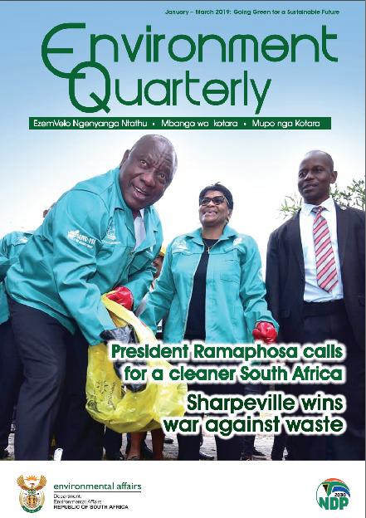
Awareness Platforms
Insert

Slide 15
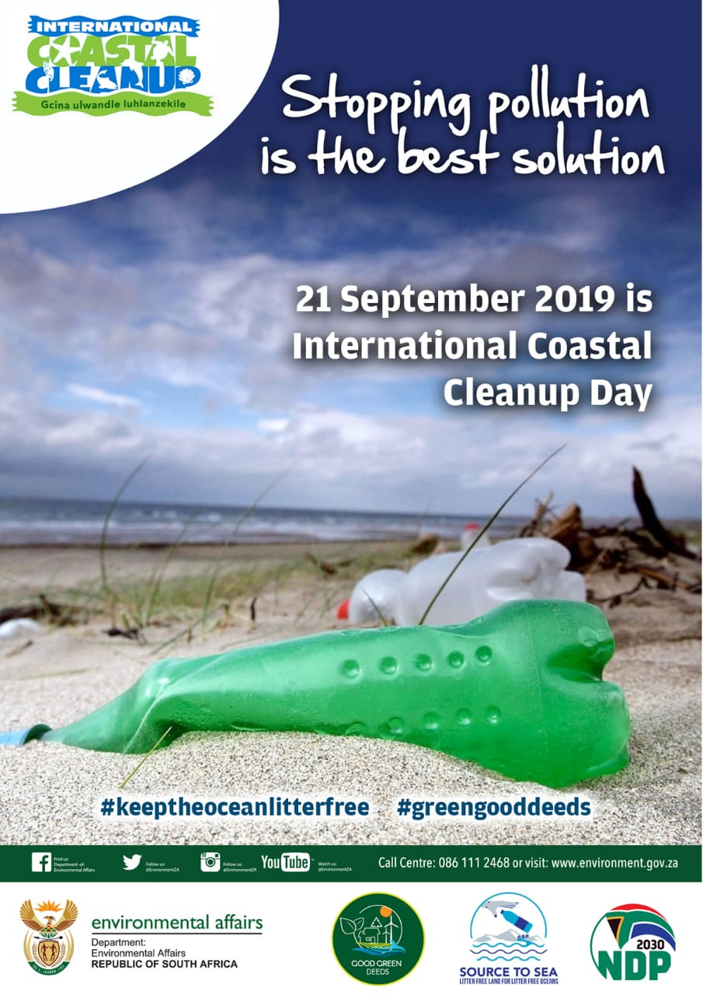
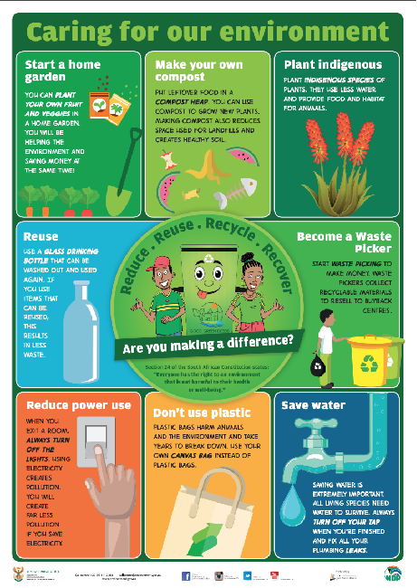
Awareness Insert and Publications

Slide 16
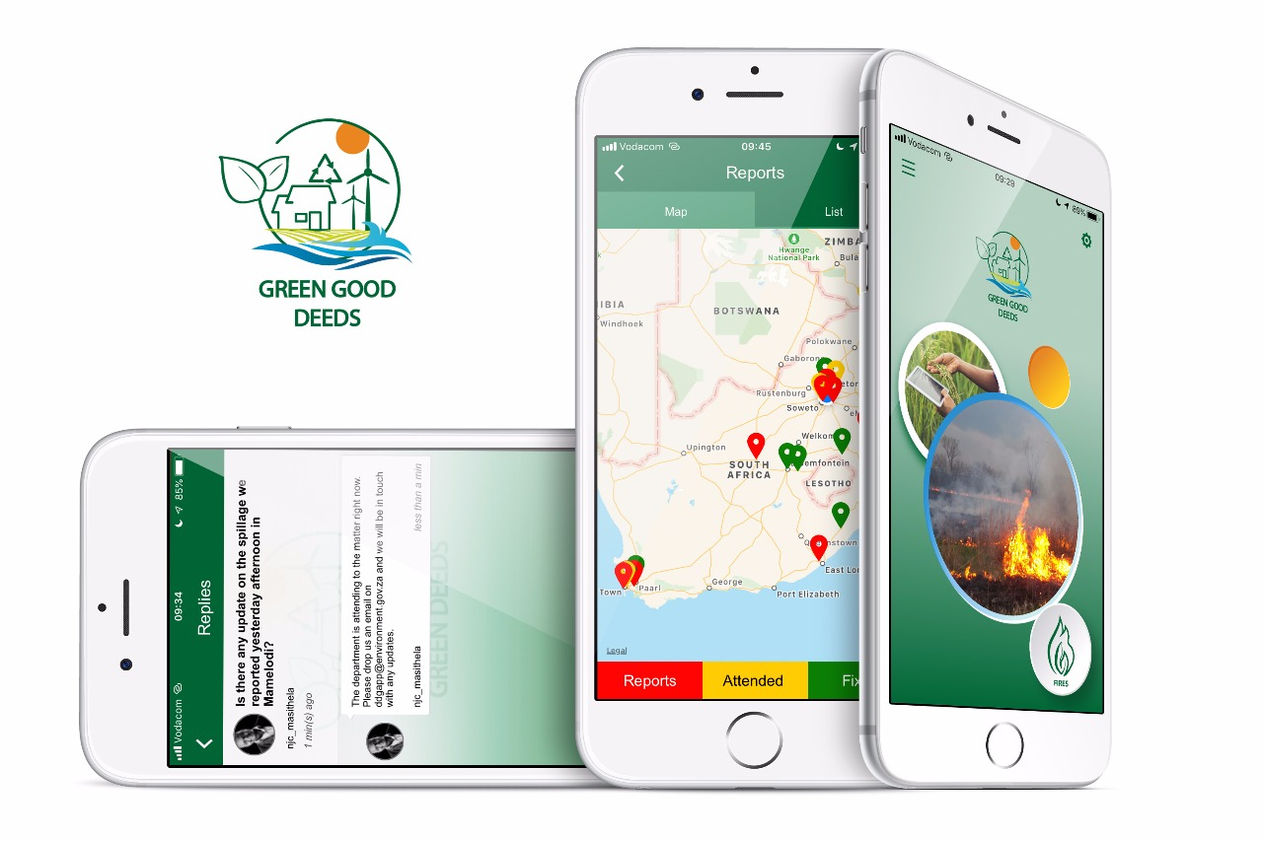
GGD Mobile Application

Slide 17
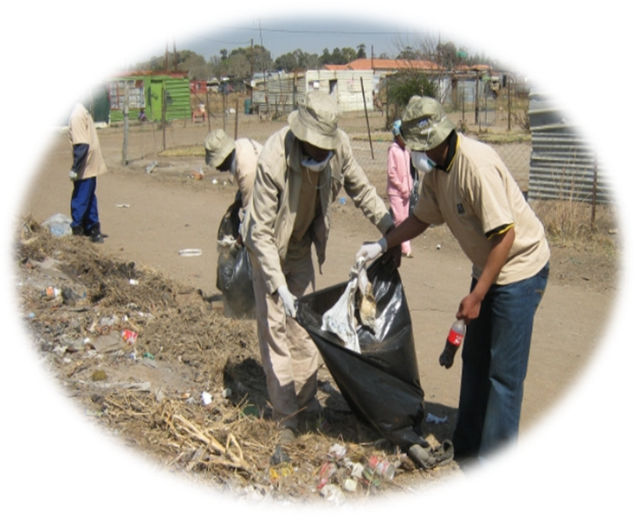
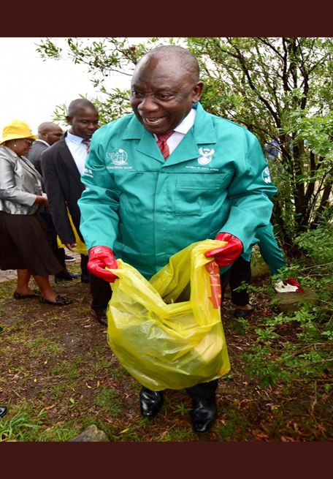
Individual Contributions to GGD

Slide 18
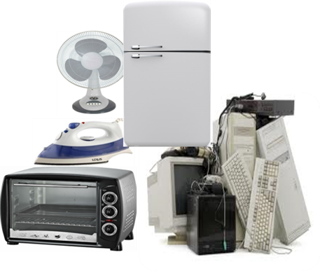
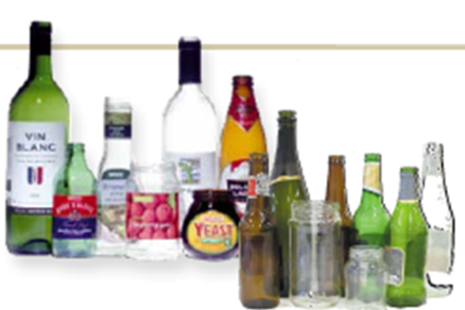
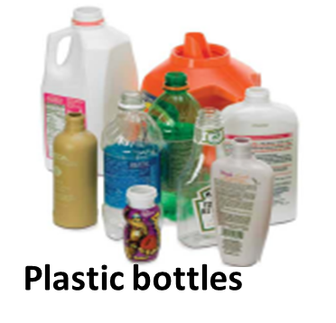
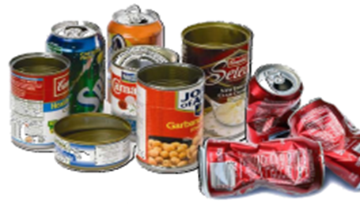
Individual Contributions to GGD
Know that waste is a valuable resource and should be recycled
SEPARATE YOUR WASTE AT SOURCE

Slide 19
Private Sector Contributions to GGD
The private sector is key in changing the approach to materials management especially for those products that become waste at the end of their useful life.
The Department has secured partnership with private stakeholders with a view of diverting waste from landfill. The Partnerships will bring about a closer working relationship and co-operate in various areas within the scope where the mandates overlap with an aim of leveraging professional networks, resources, expertise and domain knowledge.
The Department and the private sector acknowledge that both are working on projects and programmes, particularly in schools’ education and awareness, SMME development, integration of waste pickers, etc. where there will be mutual benefit in collaboration

Slide 20
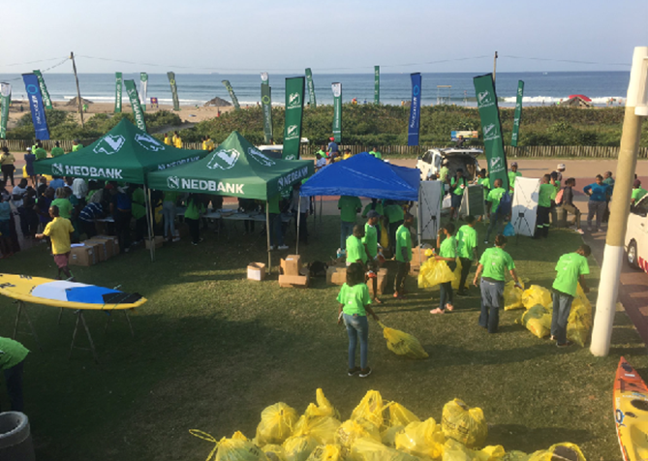
Private Sector Contributions to GGD
Some of the organizations that have collaborated with the Department include:
Coca-Cola Beverage South Africa (CCBSA)
PETCO
PLASTICS SA
Nedbank
PAMSA
IUCN
Sustainable Seas Trust
SASOL
Department of Small Business Development

Slide 21
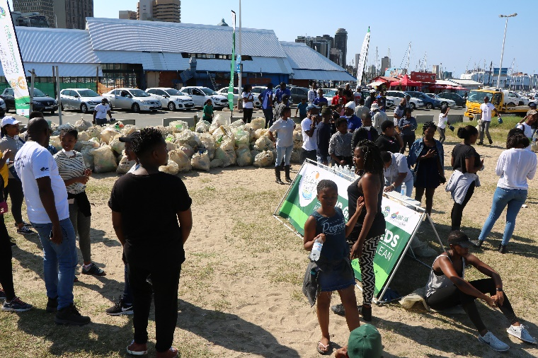
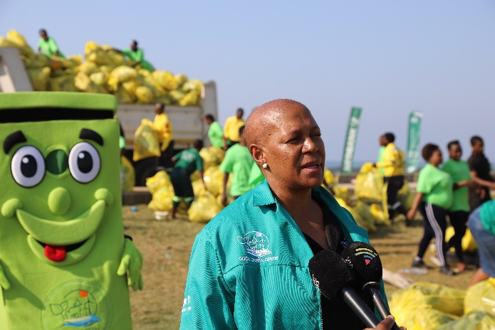
Community Outreach GGD
Know that waste is a valuable resource and should be recycled
The Department has led various community Outreach Programmes in various regions of the country.
Partnerships with various civil society organisations aimed at scaling up levels of awareness and partnerships.
:

Slide 22
DEFF Expectations
Enhance the knowledge of good waste management principles in communities on the citizenry.
Mobilize citizens, Politicians, Industry etc to take a firm position against littering and illegal dumping.
Highlight the possible socio-economic opportunities in waste management.
Diversion of waste away from the landfill sites
To raise awareness to the citizens on the wider environmental issues

Slide 23
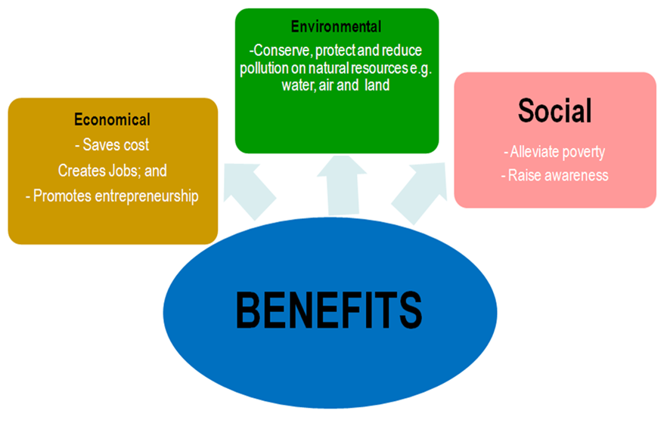
Conclusion
We all need to work together to achieve the benefits of taking care of our environment

Slide 24
Thank You

